Slide 1
IR system Phrase query
Yatharth Kale(111915140)
Ashish Shetty(111915121)

Slide 2
Problem statement
Retrieve all relevant documents based on phrase query
Provide spelling correction in case of incorrect query
Provide summary for retrieved documents

Slide 3
Overview
Implement a web application for document retrieval
Apply lemmatization on documents as well as the query
Retrieve documents based on phrase query
Use tf-idf score to rank the retrieved documents
Spelling correction in query
Print summary for the retrieved documents

Slide 4
Methods

Slide 5
UI Design
The web application is made using flask and python.
The front end is developed using bootstrap and css.
The search bar accepts the query and the retrieved documents are shown as a list.
A suggestion for the incorrect query is also presented.
A short summary of the documents is given.

Slide 6
Documents and term processing
The terms in the documents are lemmatized and a posting list with positional index is created. Lemmatization is applied using nltk library
A phrase query can be used to retrieve the relevant documents from the system. The query is lemmatized and the documents that contain any of the terms from the query is retrieved.

Slide 7
TF-IDF (Term Frequency- Inverted document frequency)
The tf-idf score is calculated for each document that will be retrieved and the documents are sorted on the basis of higher to lower score.
The documents that match the query exactly are given a score of 100.
The rest of the documents are ranked according to tf-idf score.
The final score that will be displayed is given by (tf-idf score/ sum of all scores) * 100.

Slide 8
Spelling correction and document summary
The phrase query will be checked for any spelling errors using the textblob and spellchecker library and suggestion will be given based on corrections.
The summary for all the retrieved documents is displayed using the nltk library.

Slide 9
Results
The below screenshots depict the retrieval system and the retrieved documents.
The scores represented are the tf-idf scores of each document

Slide 10
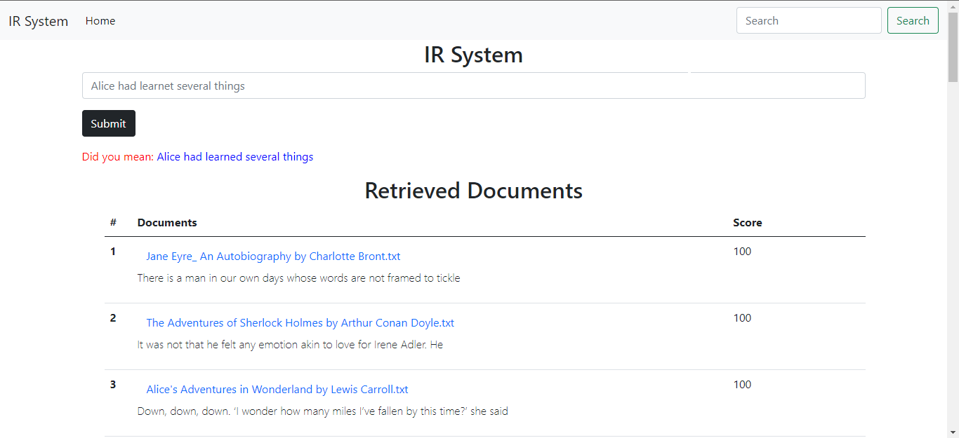

Slide 11
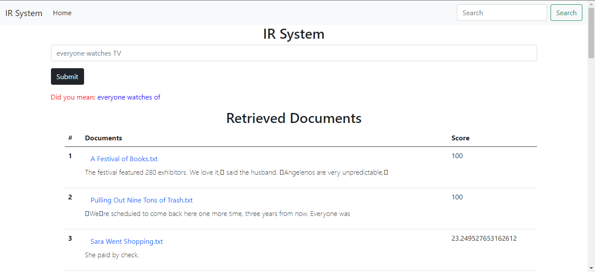

Slide 12
